Slide 1

Coronary Artery Disease
dr. Putra Antara, Sp.JP December 2019

Slide 2
What’s Coronary Disease?

Slide 3
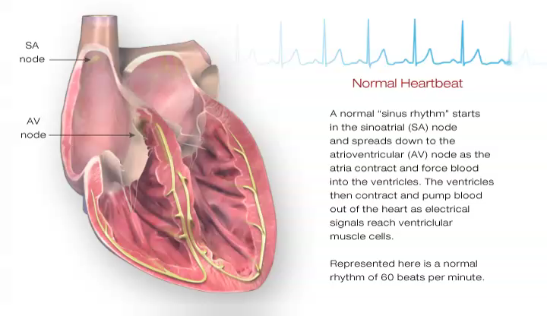
Normal Heart

Slide 4
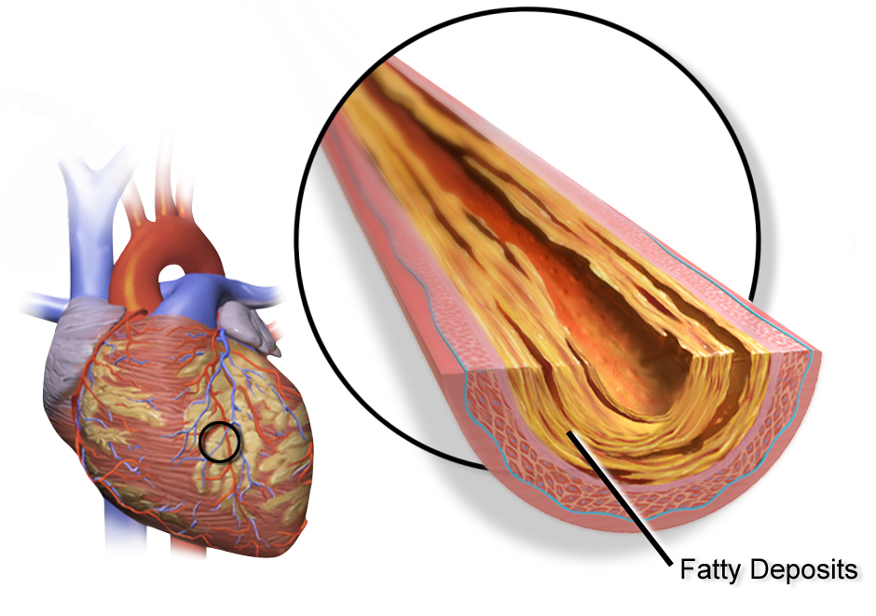

Slide 5
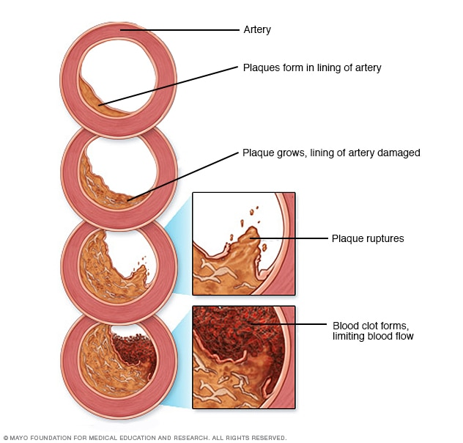

Slide 6
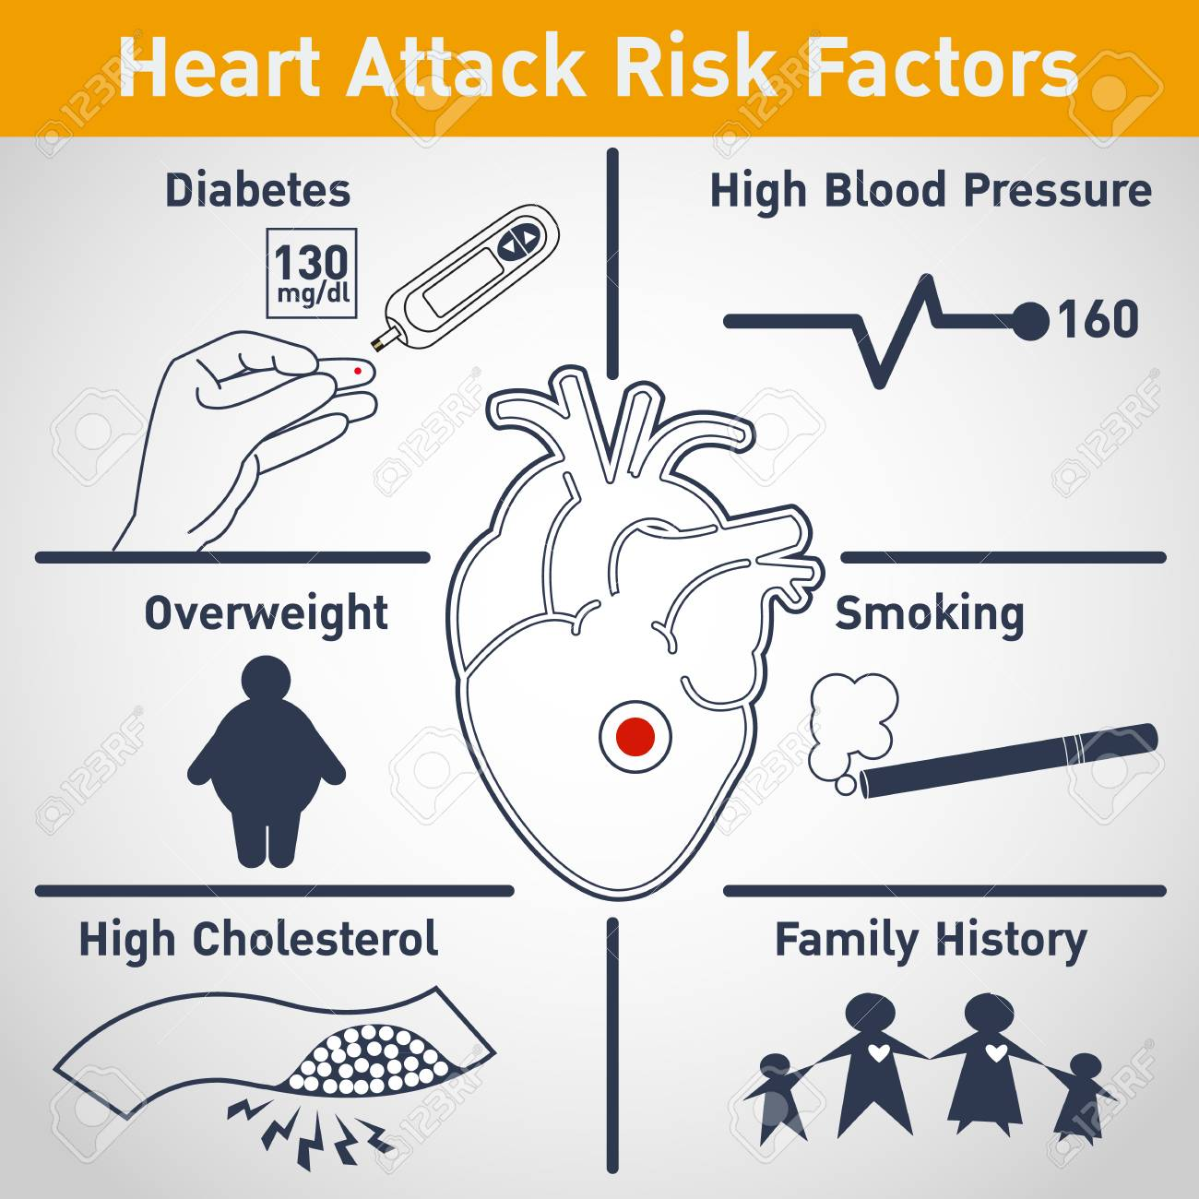

Slide 7
The Burden of CAD

Slide 8
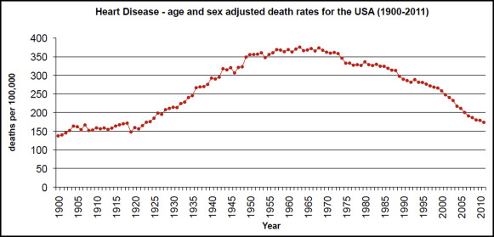
Death from Heart Disease
Notes:
http://amjmed.org/trends-in-coronary-atherosclerosis-a-tale-of-two-population-subgroups/

Slide 9
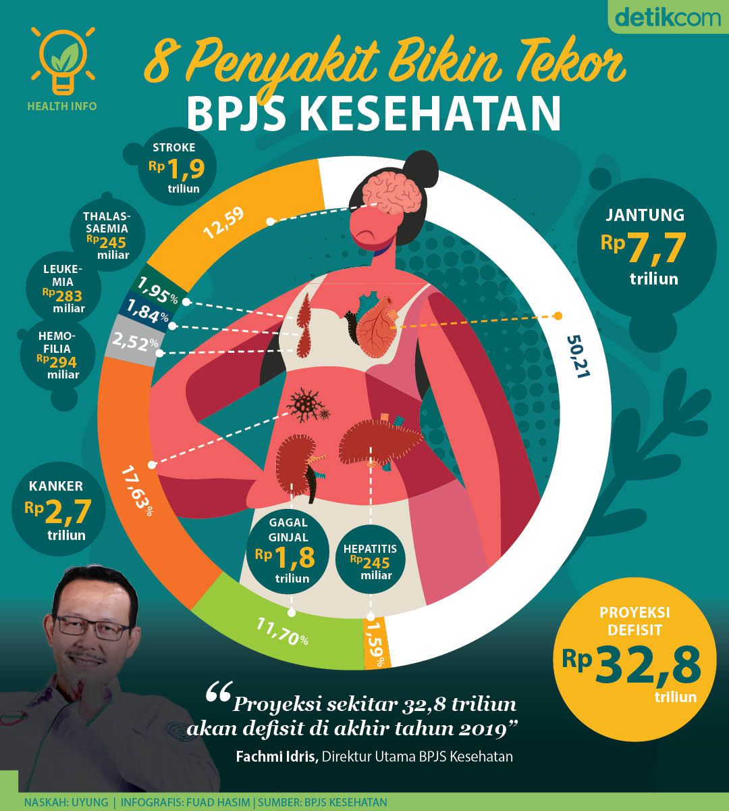

Slide 10
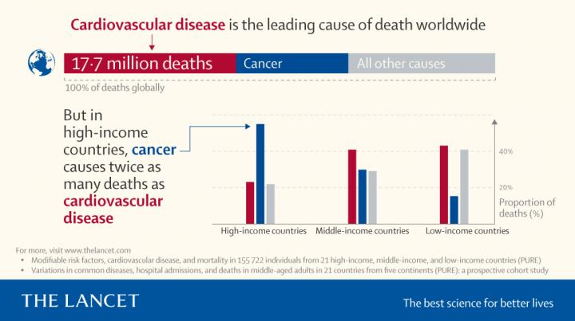

Slide 11
Diagnosis of CAD

Slide 12

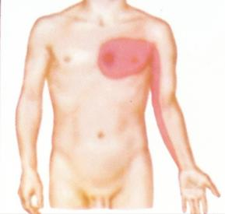
The Classical Presentation

Slide 13
“Typical” Angina Pectoris
Substernal chest discomfort of characteristic quality and duration
Provoked by exertion or emotional stress
Relieved by rest and/or nitrates

Slide 14
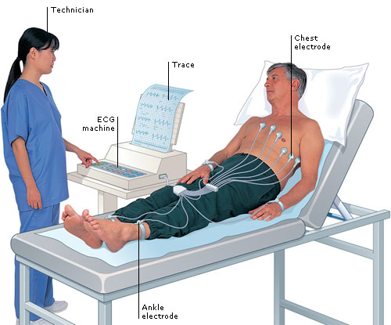
Electrocardiogram (ECG)

Slide 15
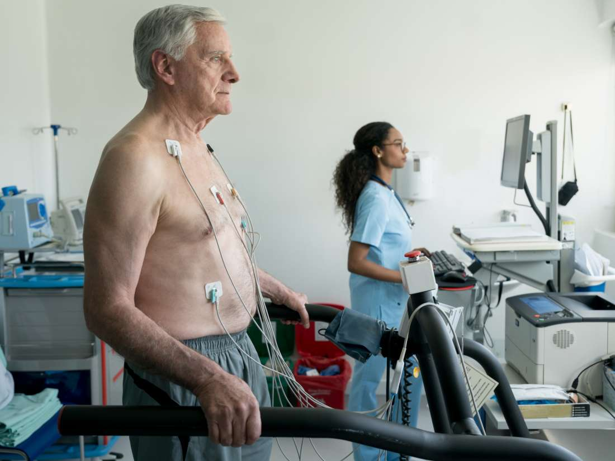
Treadmill Stress Test

Slide 16
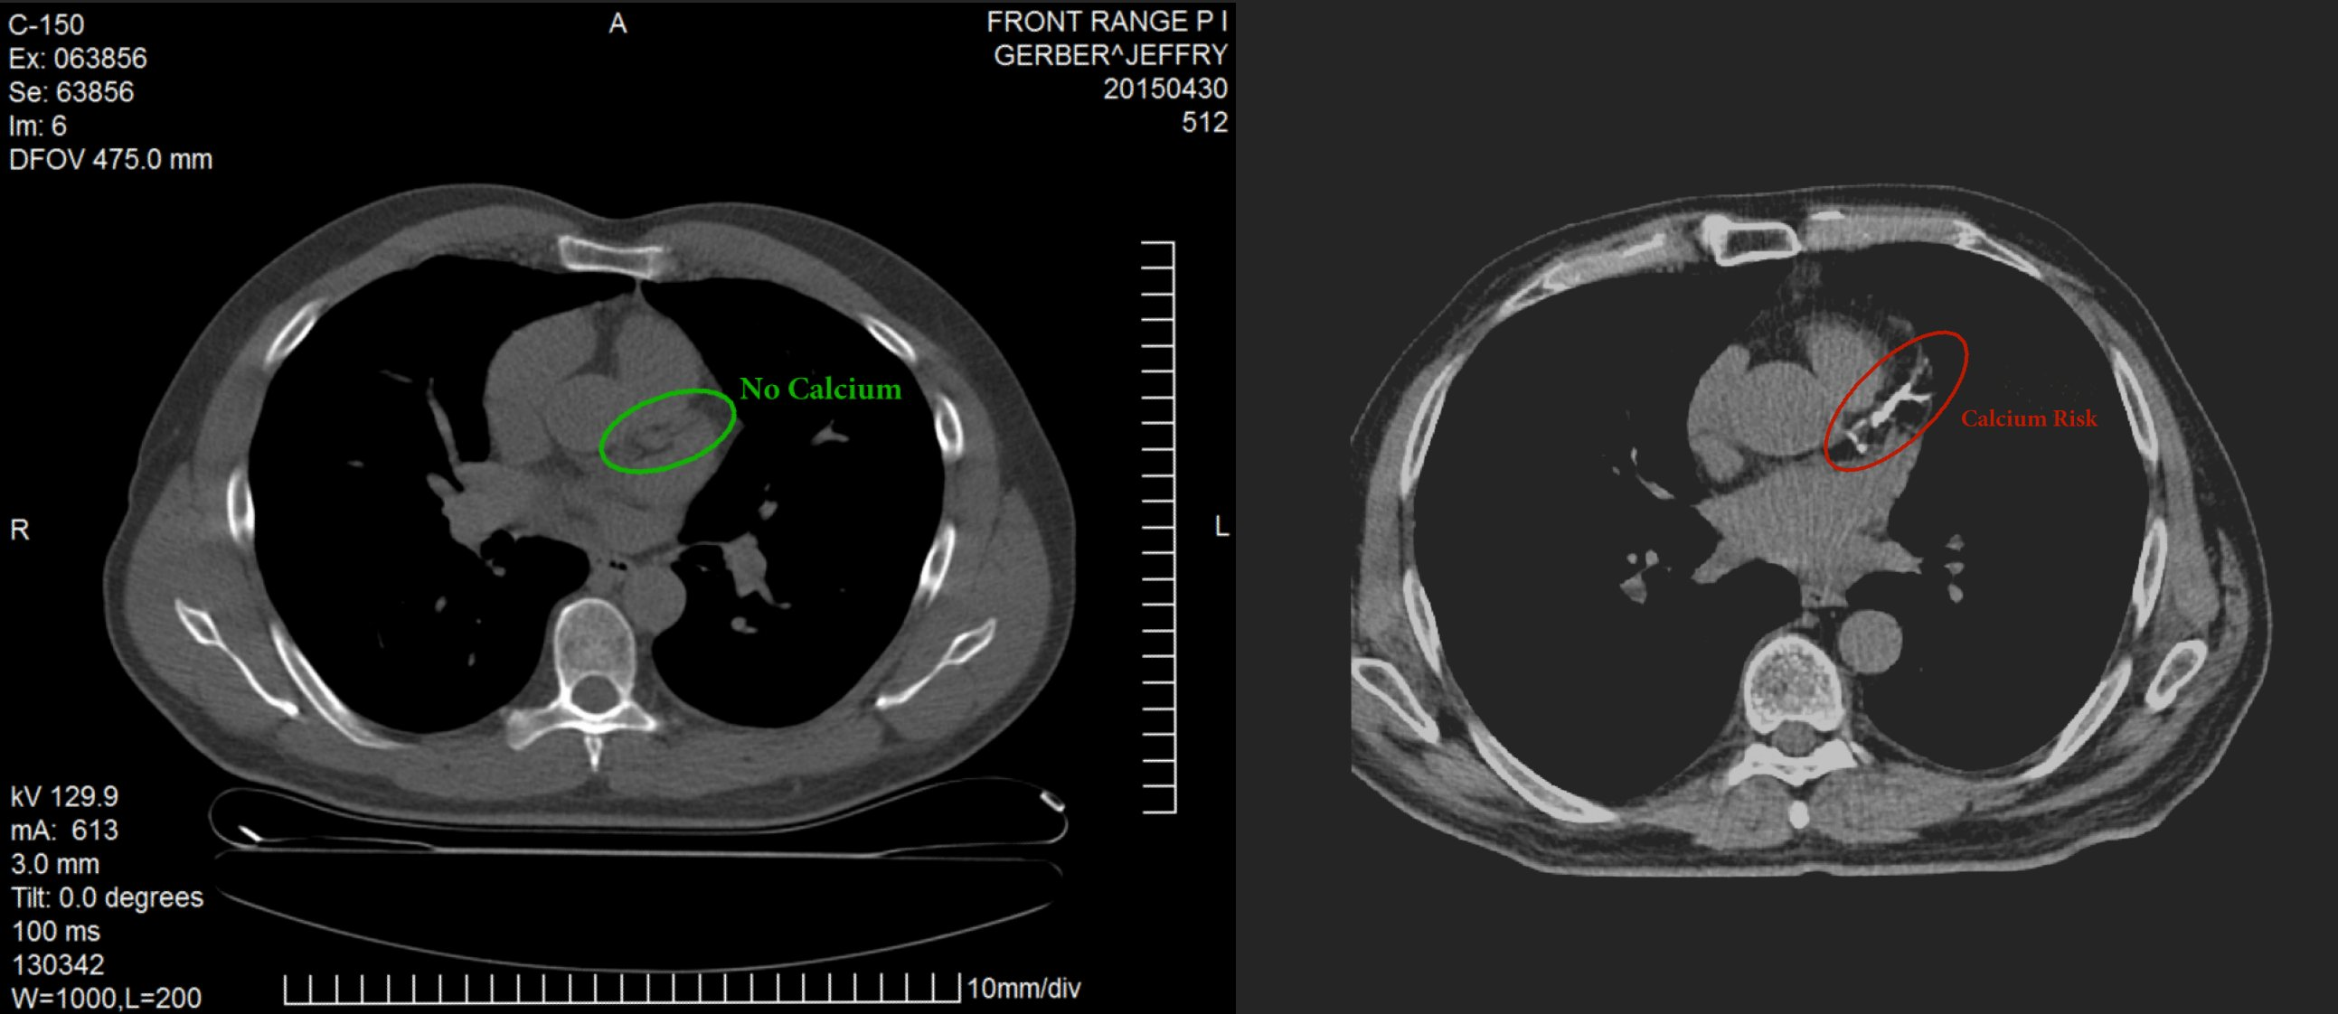
Coronary Calcium Scoring

Slide 17
Treatment of CAD or Heart Attack

Slide 18
Notes:
Nucleus Video (large)

Slide 19
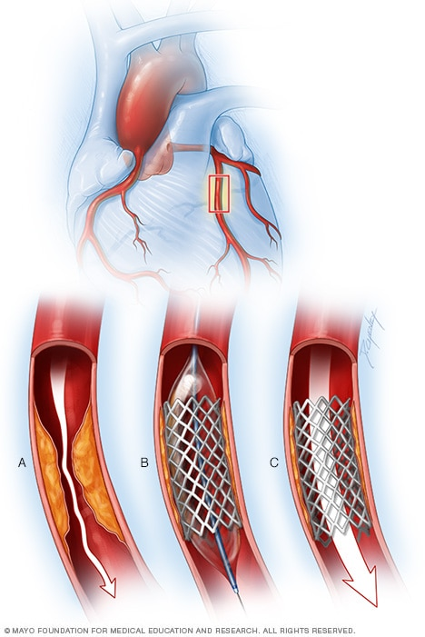
Coronary Stenting / PCI

Slide 20
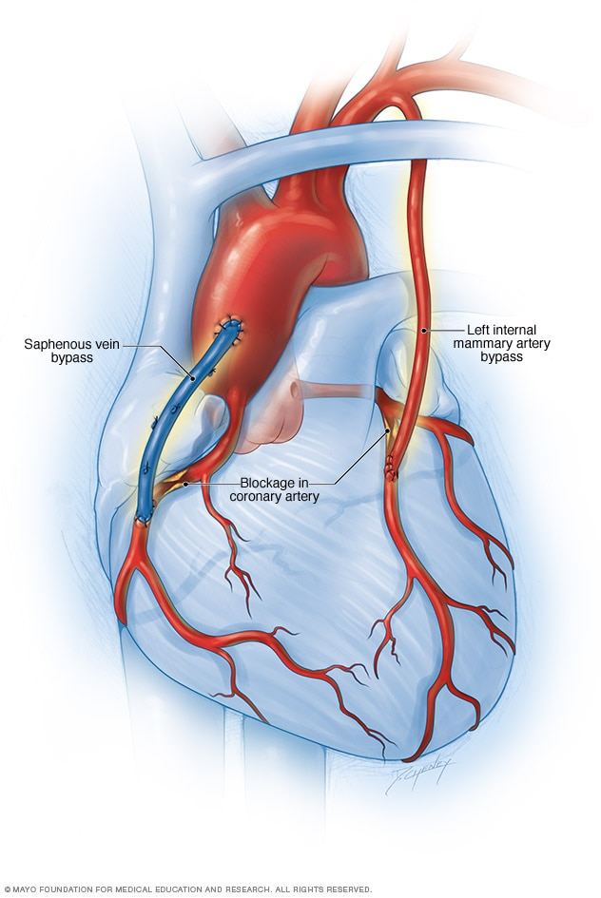
Coronary Bypass Surgery

Slide 21
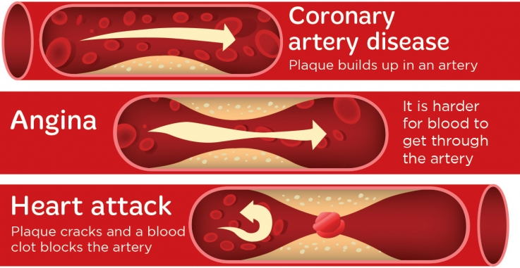
Important Distinction

Slide 22
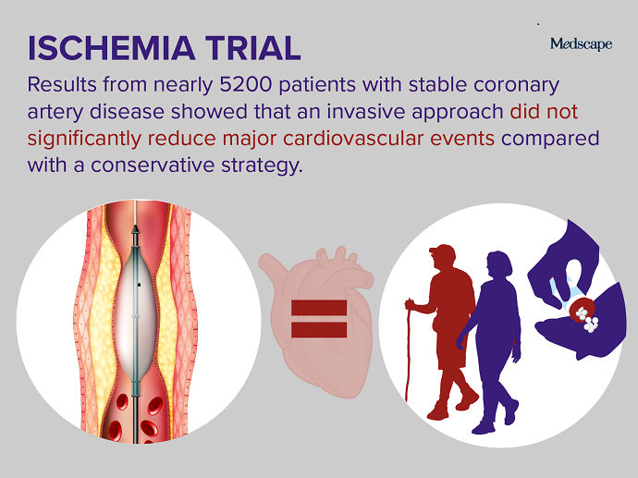

Slide 23
Prevention

Slide 24


Slide 25


Slide 26
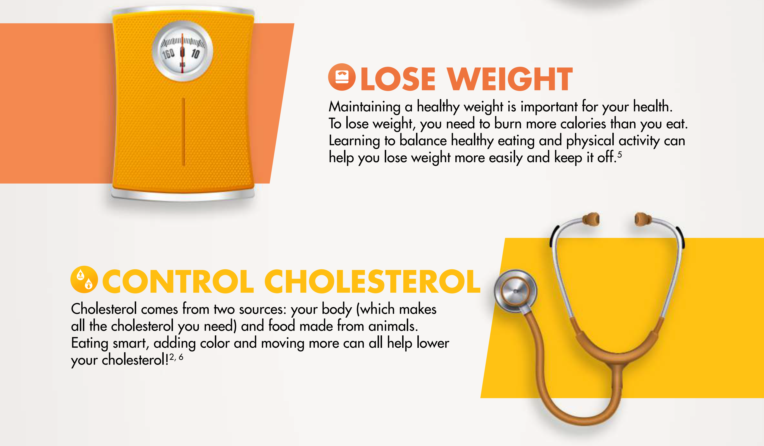

Slide 27
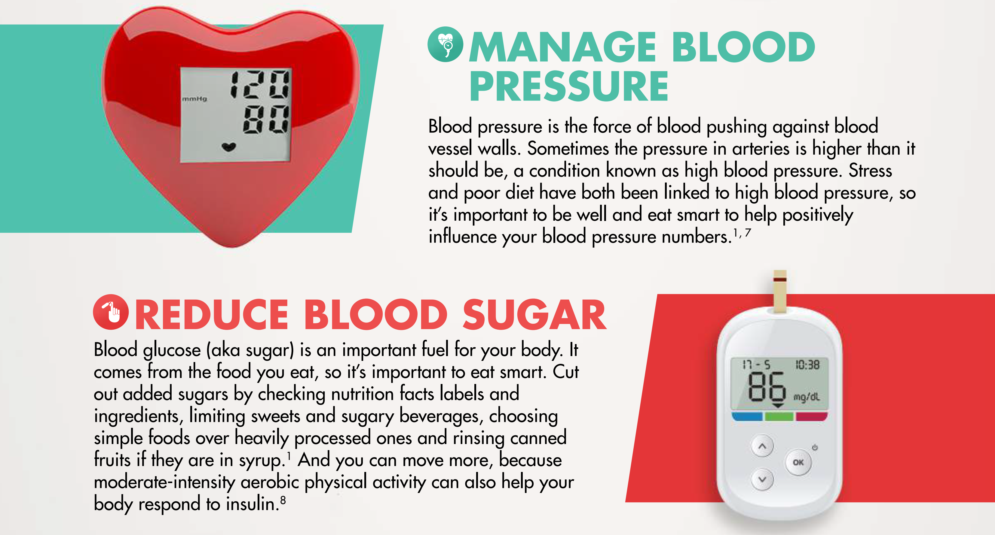

Slide 28


Slide 29
Take Home Messages
Coronary Artery Disease is a very common disease, especially among the elderly.
Symptoms of a heart attack needs to be identified properly for appropriate treatment
Adopting a positive lifestyle is never too late.

